Slide 1



Divide & Conquer

Slide 2

Divide and Conquer
Divide and Conquer is a runtime improvement technique, that you can apply on top of existing algorithms of any type (Brute Force, Greedy, Dynamic Programming, etc.)
MergeSort and QuickSort are the standard examples of Divide and Conquer.
Take a large problem, and break it up into two or more smaller pieces (divide)
Recursively solve the smaller pieces, by continuing to break them up until you reach constant-sized base cases.
Merge your solved pieces together to get the overall solution (conquer)

Slide 3

Recursion
Dynamic Programming recursion is completely different than Divide & Conquer recursion.
DP recursion is sequential (bite-sized decisions)
D&C recursion is parallelized, with each subproblem independent of the others.
DP recursion can be turned into a much more efficient iterative algorithm.
D&C recursion is hard to unroll, and does not net an asymptotic improvement to runtime.

Slide 4
Counting Inversions
You are writing software for Pandora270.
Each user ranks some number n of songs, from favorite to least favorite.
You want to find users with similar tastes in music, so that you can recommend songs.
You will take the songs that two users have in common, and compare their relative rankings.
User 1 ranks 5 songs, conveniently named 1, 2, 3, 4, 5, ranked in that order.
User 2 ranks them 1, 3, 4, 2, 5. How similar are these rankings?
In one sense, they only agree on their favorite and least favorite songs, so they are 40% similar.
Why is that an unfair metric?

Slide 5

Inversions
1 2 3 4 5
1 3 4 2 5
How many songs do we actually disagree on?
Just song 2, which is off by two places.
An inversion is a pair of songs i and j, such that i < j, but song j ranked better than song i.
How many inversions could there be for n songs?
C(n,2) = $\frac{n(n−1)}{2}$, or 10 when n=5.
What are our inversions for the above example?
{2,3} and {2,4}.
We have 2 out of 10 possible inversions, so we should say that our lists are 80% similar.

Slide 6
Brute-Force
We want to count the number of inversions in a list of n numbers (or n songs).
There are Θ(n²) possible inversions, so we could count each inversion in quadratic time by checking each one manually.
Maybe we can do better, using Divide & Conquer!
Consider the following ranking:
1 5 4 8 10 2 6 9 12 11 3 7
Divide in O(1) time:
1 5 4 8 10 2 | 6 9 12 11 3 7
Recursively solve each piece:
5 inversions | 8 inversions
Then merge our two solutions together.

Slide 7
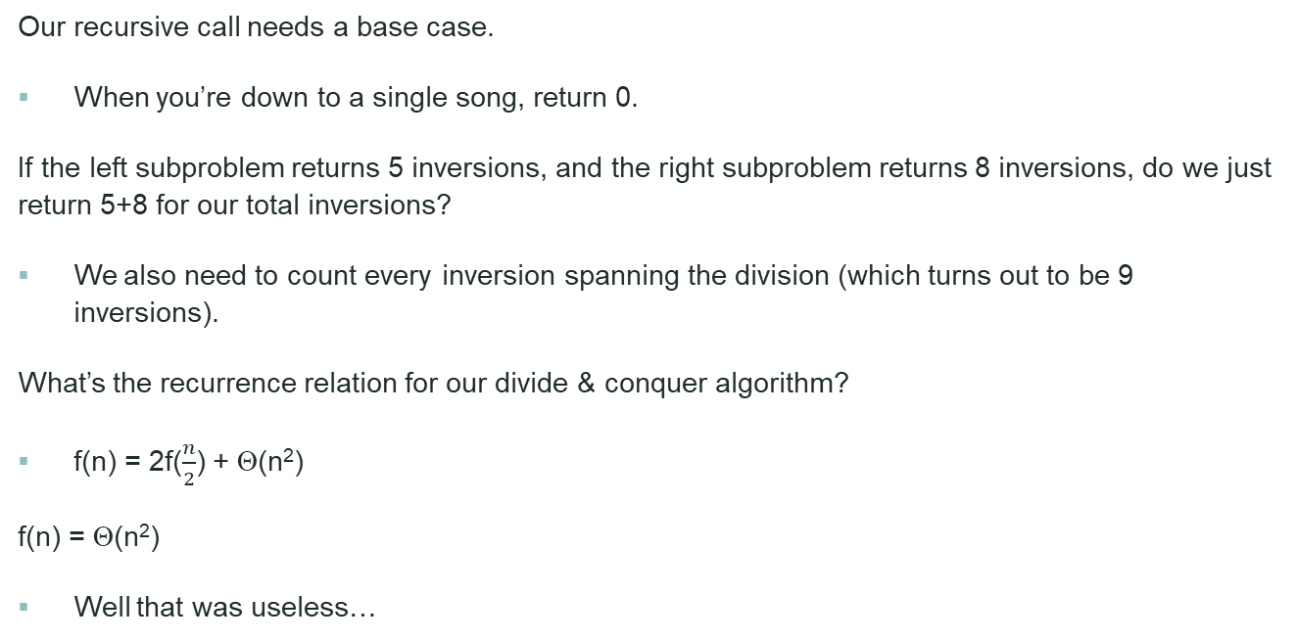
A First Attempt
Our recursive call needs a base case.
When you’re down to a single song, return 0.
If the left subproblem returns 5 inversions, and the right subproblem returns 8 inversions, do we just return 5+8 for our total inversions?
We also need to count every inversion spanning the division (which turns out to be 9 inversions).
What’s the recurrence relation for our divide & conquer algorithm?
f(n) = 2f($\frac{n}{2}$) + Θ(n²)
f(n) = Θ(n²)
Well that was useless…

Slide 8


Slide 9
A Second Attempt
Often your first attempt at a D&C algorithm will net no improvement. It will identify which part of the algorithm needs to be improved.
The combine phase is the problem.
How would we need to store the songs in each list, so as to count the inversions more easily?
How does MergeSort merge so easily?
We will both count inversions and sort the list.
We are not losing any information, because we’ve already counted the inversions we’re eliminating when sorting.

Slide 10
The Algorithm
1 5 4 8 10 2 6 9 12 11 3 7
1 5 4 8 10 2 | 6 9 12 11 3 7
5 inversions | 8 inversions
1 2 4 5 8 10 | 3 6 7 9 11 12
When pulling from the right list, we check how many numbers are remaining in the left list (n-i+1, where n is the total number in the left list, and i is our iterator).
In linear time, we both merged the two lists, and counted up the 9 inversions.
This is the MergeSort variant for counting inversions, and thus achieves n log n: BubbleSort is the traditional n² algorithm for this.
2
4
5
8
10
6
7
9
11
1
2
3
4
5
6
7
8
9
10
11 12
+4
+2
+2
+1

Slide 11
All-Pairs Shortest Paths Strikes Back
ASP[i,x,z] stores the length of the shortest path from x to z, using ≤ i edges.
ASP[i,x,x] = 0
ASP[0,x,z] = ∞
ASP[i,x,z] = min_{⟨x,y⟩∈E}(c_{⟨x,y⟩} + ASP[i-1, y, z])
For i = 0 to n-1
For all nodes z
For all nodes x
Calculate ASP[i,x,z]
Answers at ASP[n-1]
Runtime = Θ(mn²)
In Dynamic Programming, we figured out which node to visit next. What would we do for Divide & Conquer?

Slide 12

All-Pairs Shortest Paths
We will figure out which node to visit in the middle.
It’s still, at its core, Dynamic Programming, as we will try all possible middle-nodes and take the best.
ASP[i,x,z] = min_{y∈V}( ASP[ ⎣$\frac{i}{2}$⎦, x, y] + ASP[ ⎡$\frac{i}{2}$⎤, y, z] )
ASP[1,x,z] = c_{⟨x,z⟩}
ASP[i,x,x] = 0
For i = 1 to n-1
For all nodes x
For all nodes z
Calculate ASP[i,x,z]
Runtime = Θ(n⁴)
…oops

Slide 13

A Second Attempt
What values of i do we actually need to calculate?
For i = 0 to log n
For all nodes x
For all nodes z
Calculate ASP[i,x,z]
ASP[i,x,z] stores the length of the shortest path from x to z, using no more than 2^{i} edges.
Answers are at ASP[2^{⎡log n⎤}]
Runtime = Θ(n³ log n)
This is usually better than running Bellman-Ford n times, but depends on how dense the graph is.

Slide 14
Integer Multiplication
Presumably you recall how to multiply numbers:
12 x 13 36 120 156
The same idea works for numbers in binary:
1100 x 1101 1100 110000 1100000 10011100

Slide 15


Elementary Math
What is the runtime to multiply two n-bit integers, using this method?
Θ(n²)
We will try to improve this, using Divide & Conquer.
We want to multiply two n-bit integers, X and Y.
Let x_{F} be the first $\frac{n}{2}$ bits of X, and x_{L} be the last bits.
Similarly for y_{F} and y_{L}.
So, x = x_{F} ⋅ 2$\frac{n}{2}$ + x_{L} and y = y_{F} ⋅ 2$\frac{n}{2}$ + y_{L}
x ⋅ y = x_{F} ⋅ y_{F} ⋅ 2^{n} + (x_{F} ⋅ y_{L} + y_{F} ⋅ x_{L}) ⋅ 2$\frac{n}{2}$ + x_{L} ⋅ y_{L}
Our base case is multiplying two 1-bit numbers.
What’s the recurrence relation?
f(n) = 4 f($\frac{n}{2}$ ) + Θ(n)

Slide 16

A Second Attempt
Where’s the problem in our recurrence relation?
The 4. We have too many subproblems.
How can we do this with only 3 subproblems?
Hint: our first multiplication will be (x_{F} + x_{L}) ⋅ (y_{F} + y_{L})
M₂ = x_{F} ⋅ y_{F}
M₃ = x_{L} ⋅ y_{L}
x ⋅ y = M₂ ⋅ 2^{n} + (M₁ – M₂ – M₃) ⋅ 2$\frac{n}{2}$ + M₃
f(n) = 3 f($\frac{n}{2}$ ) + Θ(n)
f(n) = Θ(n^{log 3}) ≈ n^{1.58}

Slide 17

Sequence Alignment
The edit distance between two strings X = x₁…x_{n} and Y = y₁…y_{m} is the minimal number of changes to transform X into Y.
SA[i,j] is the edit distance of X = x_{i}…x_{n} and Y = y_{j}…y_{m}.
SA[i,m+1] = n+1-i
SA[n+1,j] = m+1-j
SA[i,j] = SA[i+1,j+1], if x_{i} = y_{j}.
SA[i,j] = 1 + min( SA[i,j+1], SA[i+1,j], SA[i+1,j+1] ), otherwise
Runtime and space are both Θ(mn)

Slide 18
Improving the space requirements
To calculate the matrix, we only need to remember the current and previous column.
Therefore, we can reduce the memory requirements to Θ(m+n)
The cost is that we cannot reconstruct the solution.
We will attempt to get the best of all worlds, using Divide & Conquer: reconstructing the answer in Θ(mn) time and Θ(m+n) space

Slide 19

The high level idea
Some prefix of Y will match with the first half of X. The rest of Y will match with the second half of X.
We don’t know where the optimal split point of Y is, so, dynamic programming-style, we will try all possible splits and take the best one.
We will run Sequence Alignment, using our memory-saving technique, on the first half of X and all prefixes of Y.
We will also run it on the second half of X and all suffixes of Y.
Then we will inspect the results and figure out where the optimal split point is.

Slide 20
The high level idea: visually
Prefix of Y | First half of X
ε | 5
y₁ | 4
y₁y₂ | 3
y₁y₂y₃ | 2
… | …
y₁…y_{m-1} | 3
y₁…y_{m} | 4
Suffix of Y | Second half of X
y₁…y_{m} | 4
y₂…y_{m} | 3
y₃…y_{m} | 2
y₄…y_{m} | 4
… | …
y_{m} | 5
ε | 6
Total
9
7
5
6
…
8
10

Slide 21
Divide & Conquer
We will have determined the total edit distance, as well as the optimal split point, using only Θ(m+n) space.
Now we repeat the process on the left-subproblem, and the right-subproblem
We repeat until we are matching substrings of Y with individual characters of X, at which point we have the full reconstruction.
x₁x₂x₃x₄ | x₅x₆x₇x₈
y₁y₂y₃ | y₄y₅y₆y₇y₈y₉
x₁x₂ | x₃x₄ | x₅x₆ | x₇x₈
y₁ | y₂y₃ | y₄y₅ | y₆y₇y₈y₉
x₁ | x₂ | x₃ | x₄ | x₅ | x₆ | x₇ | x₈
y₁ | ε | y₂ | y₃ | y₄y₅ | ε | y₆y₇ | y₈y₉

Slide 22
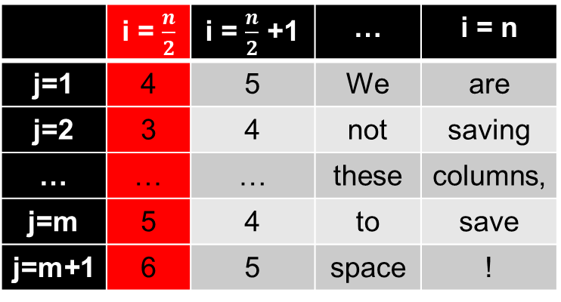
Sequence Alignment on the last half of X, and suffixes of Y
Run Sequence Alignment on the last half of X and all of Y (using our space-saving technique).
The first column stores the edit distances of all possible suffixes of Y with the last half of X.
 | i = $\frac{n}{2}$ | i = $\frac{n}{2}$ +1 | … | i = n
j=1 | 4 | 5 | We | are
j=2 | 3 | 4 | not | saving
… | … | … | these | columns,
j=m | 5 | 4 | to | save
j=m+1 | 6 | 5 | space | !
Runtime = Θ(mn)

Slide 23
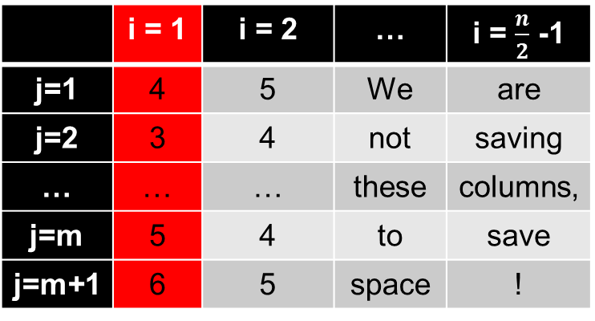
Sequence Alignment on the first half of X, and prefixes of Y
Run Sequence Alignment on the first half of X and all of Y (using our space-saving technique).
Does the first column store the edit distances of all possible prefixes of Y with the first half of X?
Nope, it’s still suffixes of Y.
 | i = 1 | i = 2 | … | i = $\frac{n}{2}$ -1
j=1 | 4 | 5 | We | are
j=2 | 3 | 4 | not | saving
… | … | … | these | columns,
j=m | 5 | 4 | to | save
j=m+1 | 6 | 5 | space | !

Slide 24
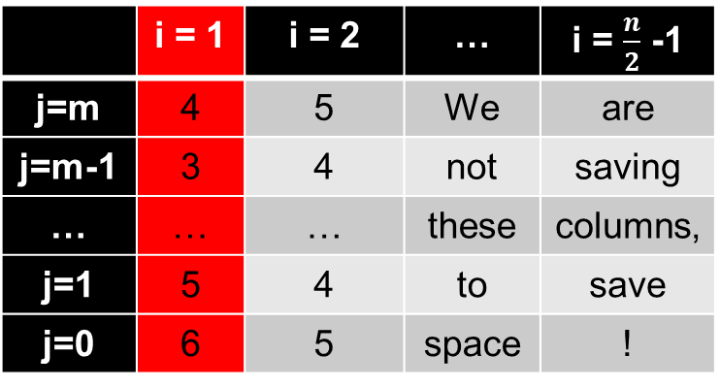
Sequence Alignment on the first half of X, and prefixes of Y, Take two
Run Sequence Alignment on the first half of X and the reverse of Y (using our space-saving technique).
Does this work now?
Nope, now we’re matching the first character of X with the last character of Y.
 | i = 1 | i = 2 | … | i = $\frac{n}{2}$ -1
j=m | 4 | 5 | We | are
j=m-1 | 3 | 4 | not | saving
… | … | … | these | columns,
j=1 | 5 | 4 | to | save
j=0 | 6 | 5 | space | !

Slide 25
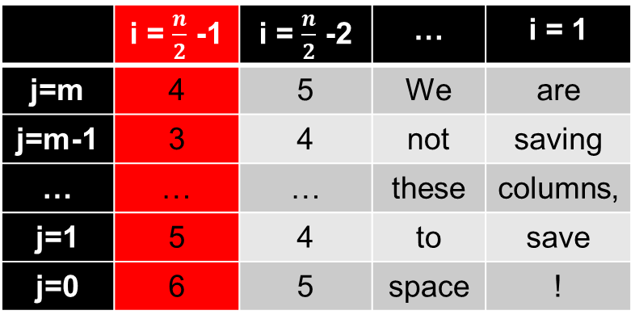
Sequence Alignment on the first half of X, and prefixes of Y, Take three
Run Sequence Alignment on the first half of X (reversed) and the reverse of Y (using our space-saving technique).
Now this works!
 | i = $\frac{n}{2}$ -1 | i = $\frac{n}{2}$ -2 | … | i = 1
j=m | 4 | 5 | We | are
j=m-1 | 3 | 4 | not | saving
… | … | … | these | columns,
j=1 | 5 | 4 | to | save
j=0 | 6 | 5 | space | !

Slide 26


Analysis
Each individual call takes only Θ(m+n) space.
Additionally, we need to store the reconstruction, but that also takes only Θ(m+n) space.
Our recurrence relation is f(n,m) = f($\frac{n}{2}$, k) + f($\frac{n}{2}$, m-k) + Θ(mn).
The next level of recursion will get runtime $\frac{n}{2}k+\frac{n}{2}\left(m−k\right)=\frac{n}{2}m$
Each successive level divides the runtime in half, so the total runtime is Θ(mn)

Slide 27
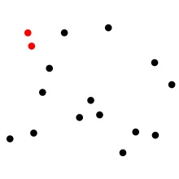
Closest Points on a Plane
Given n points on a plane (specified by their x and y coordinates), find the pair of points with the smallest Euclidean distance between them.
What would be the runtime for a Brute-Force algorithm?
Θ(n²)

Slide 28
Divide & Conquer
How should we divide the problem?
We can divide at the median x-coordinate, so that half of the points are on the left, and half of the points are on the right.
If we also try to split on the y-coordinate, there is no guarantee we will be able to split the problem into equal quarters.

Slide 29

Recursion
We will continually split the problem until we have 2-3 points, and then we will brute-force identify the closest pair of points among them.
So, if I’ve found the closest pair of points on the left, with distance δ, and the closest pair of points on the right, with distance ε, do I just return min(δ, ε)?
We also need to check points that span the divide. If we brute force this, we’ll get the following recurrence:
f(n) = 2f($\frac{n}{2}$)+Θ(n²)

Slide 30
The Combine Phase, Take Two
Do I really need to compare all pairs of points that span the divide?
Assume δ is the smallest distance over both subproblems. Then we only need to look at points that are within δ of the dividing line.
Does this improve our runtime?

Slide 31

The Combine Phase, Take Three
Do I really need to compare all pairs of points within δ of the dividing line?
For each point, I only need to look at the points on the other side that are within δ of the given y-coordinate.
Does this improve the runtime?
It does! Since the smallest pair of points on the right side are at least δ apart, we can only fit a constant number of points in the rectangle!
The new recurrence is f(n) = 2f($\frac{n}{2}$)+Θ(n)
2δ
δ
2δ
δ

Slide 32
Details of Implementation
Sort the list of points (list 1) by x-coordinate: Θ(n log n)
Sort the list of points (list 2) by y-coordinate: Θ(n log n)
Use list 1 to figure out the division in constant time, and recursively call the algorithm.
Walk through list 2, and pull out the points that are within δ of the dividing line (list 3).
For each point in list 3, compare it with each successive point in list 3 until you are over δ away from that point: this is a constant number of comparisons.

Slide 33

Matrix Multiplication
The standard way to multiply matrices:
$$\left(\begin{matrix}a11 & a12 \\ a21 & a22\end{matrix}\right)\left(\begin{matrix}b11 & b12 \\ b21 & b22\end{matrix}\right)=\left(\begin{matrix}a11b11+a12b21 & a11b12+a12b22 \\ a21b11+a22b21 & a21b12+a22b22\end{matrix}\right)$$
$$\text{c}\text{ij}\text{ =}\sum_{k}{aikbkj}$$
Using this method, how long will it take to multiply two n by n matrices?
Θ(n³)

Slide 34

Divide & Conquer
We can divide our n by n matrices into 4 quadrants:
$$\left(\begin{matrix}A & B \\ C & D\end{matrix}\right)\left(\begin{matrix}E & F \\ G & H\end{matrix}\right)=\left(\begin{matrix}AE+BG & AF+BH \\ CE+DG & CF+DH\end{matrix}\right)$$
Then we need to figure out how to multiply two $\frac{n}{2}$ by $\frac{n}{2}$ matrices together (AE, BG, AF, BH, CE, DG, CF, DH).
We continue to break these down until we’re multiplying scalars.
What’s the recurrence relation?
f(n) = 8f($\frac{n}{2}$) + Θ(n²)

Slide 35


Divide & Conquer, Take Two
It is possible to reduce the number of multiplies:
M₁ = A(F-H)
M₂ = (A+B)H
M₃ = (C+D)E
M₄ = D(G-E)
M₅ = (A+D)(E+H)
M₆ = (B-D)(G+H)
M₇ = (A-C)(E+F)
$$\left(\begin{matrix}A & B \\ C & D\end{matrix}\right)\left(\begin{matrix}E & F \\ G & H\end{matrix}\right)=$$ $$\left(\begin{matrix}AE+BG & AF+BH \\ CE+DG & CF+DH\end{matrix}\right)=$$ $\left(\begin{matrix}\text{M}\text{5}+\text{M}4−\text{M}2+\text{M}6 & \text{M}1+\text{M}2 \\ \text{M}3+\text{M}4 & \text{M}1+\text{M}\text{5}−\text{M}3−\text{M}7\end{matrix}\right)$
f(n) = 7f($\frac{n}{2}$) + Θ(n²)
f(n) = Θ(n^{log 7}) ≈ Θ(n^{2.81})
For n = 2500, this has a speedup factor of 8

Slide 36
Improvements
This is known as Strassen Multiplication, and was discovered in 1969.
In 1971, Hopcroft and Kerr showed that 6 multiplies is impossible
In 1980, Pan showed that if you split the matrix up into 70² sectors, you can achieve 143640 multiplies ≈ Θ(n^{2.80})
In December 1979, we got a general O(n^{2.521813}) algorithm.
In January 1980 this was improved to O(n^{2.521801})
In 1987, Coppersmith and Winograd achieved O(n^{2.376})
There have been small improvements starting in 2010
Hypothesis: O(n^{2+ε}) is possible

Slide 37
Take-Home Practice
Chapter 5
Exercises 1, 2, 3, 6, 7

